Slide 1
APA Essentials
How do I cite this $#!%????
Seventh Edition!

Slide 2
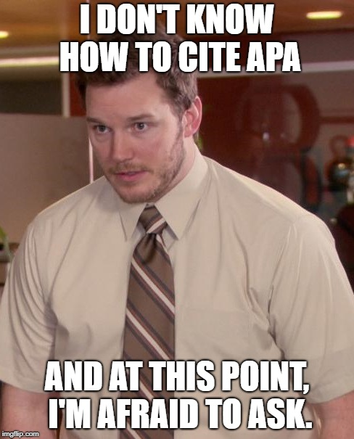
Overview
the purpose of citing and referencing in academic writing
when and how to properly cite your sources
what kinds of information require citation
how to integrate quotes and other information into your writing
basic APA citation guidelines.

Slide 3
CITING AND REFERENCING
In-Text Citations: The short (parenthetical) notes that indicate when an idea presented in your writing relies upon the work/thinking of another.
References: These are detailed notes at the end of the paper that identify the authors, titles, publishers, and any other important information about the resources you have consulted.

Slide 4
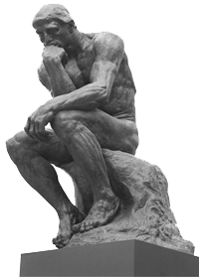
Why Cite?

Slide 5
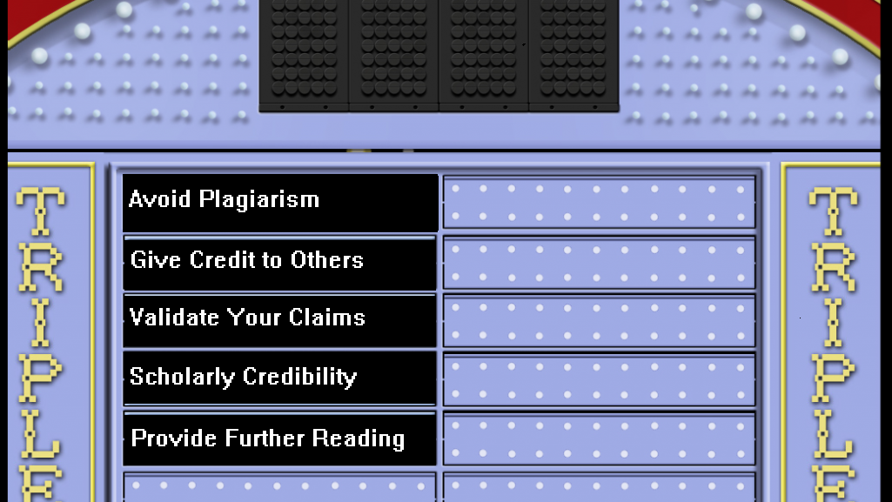

Slide 6
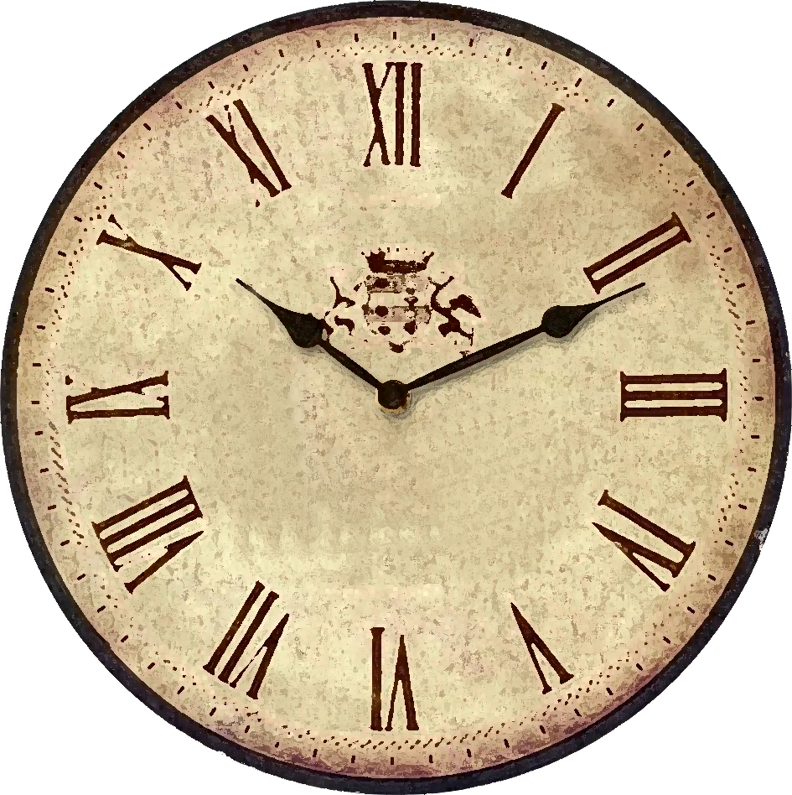
When to cite?

Slide 7

When Should You Cite?
You need to provide citations and references whenever an idea you present or statement you make is dependent on the work of others.

Slide 8
Three Instances
Direct Quotes
Paraphrased Passages
Summaries

Slide 9
Direct Quotation
Three significant words or more require “quotation marks.”
Their citations require author’s name, year of publication, and a page number.
In APA, paraphrasing is preferred.

Slide 10
Paraphrasing
Frame ideas from the source in your own words.
The authors last name and year of publication is required.
Creates consistency when citing material written in a different tense or perspective.

Slide 11
Summary
A summary is simply an outline of the key points to an argument put in a succinct way.
This is done to minimize the number of words you use, and focus on key points relevant to your argument.
The authors last name and year of publication is required.

Slide 12

What Gets Cited?

Slide 13
To Cite, or Not to Cite?
What you have to cite
Uncommon knowledge
What you don’t cite
Common knowledge
Proverbs, expressions
Common opinions
Contested theories and facts
Stats
Images, graphs, and tables
Perspectives other than your own
Specific words or phrases
Any original idea or research!

Slide 14

Not sure if you need a citation?
CITE ANYWAY!!

Slide 15

HOW TO CITE

Slide 16
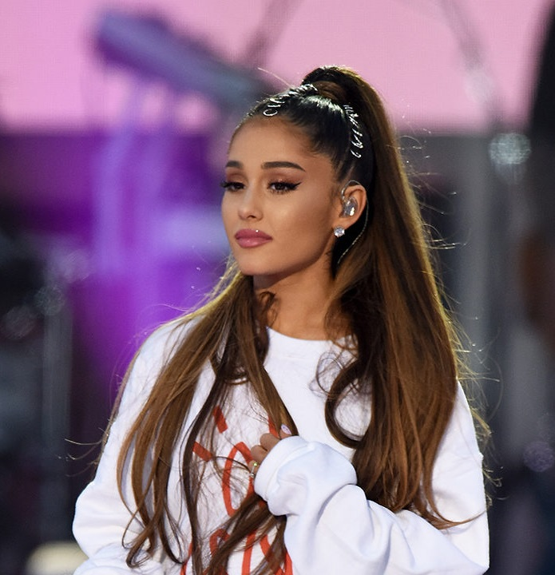
How to Cite: Direct Quotes
Split Citations
Grande (2019) suggests that “there are no tears left to cry” (p. 45).
Single Citation
Evidence suggests that “there are no tears left to cry” (Grande, 2019, p. 45).

Slide 17
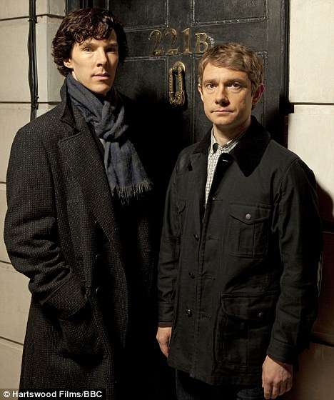
How to Cite: Paraphrase/Summary
Before
Holmes and Watson (2017) suggest that deductive reasoning can help solve crimes.
After
Deductive reasoning can help solve crimes (Holmes & Watson, 2017).

Slide 18

Adding Commentary After a Cited Material
If you add commentary after a citation within the same sentence, always be sure to insert the citation where the source’s information ends and your commentary begins so that the two are not confused:
Example: One researcher argues that you should not hate the player, but rather the game (Durant, 2017), which is practical advice.

Slide 19
Rules for Multiple Authors
Two
Three or more

Slide 20
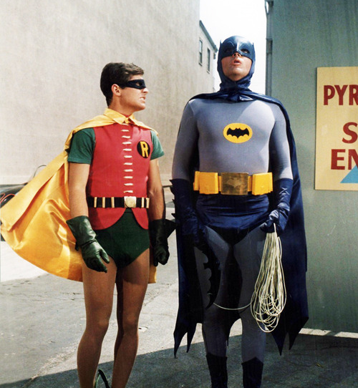
Citing Two Authors
Wayne and Grayson (2016) argue that wearing spandex makes crime fighting easier.
Subsequent Citations
Penguins and cats can be devious (Wayne & Grayson, 2016).
First Citation

Slide 21
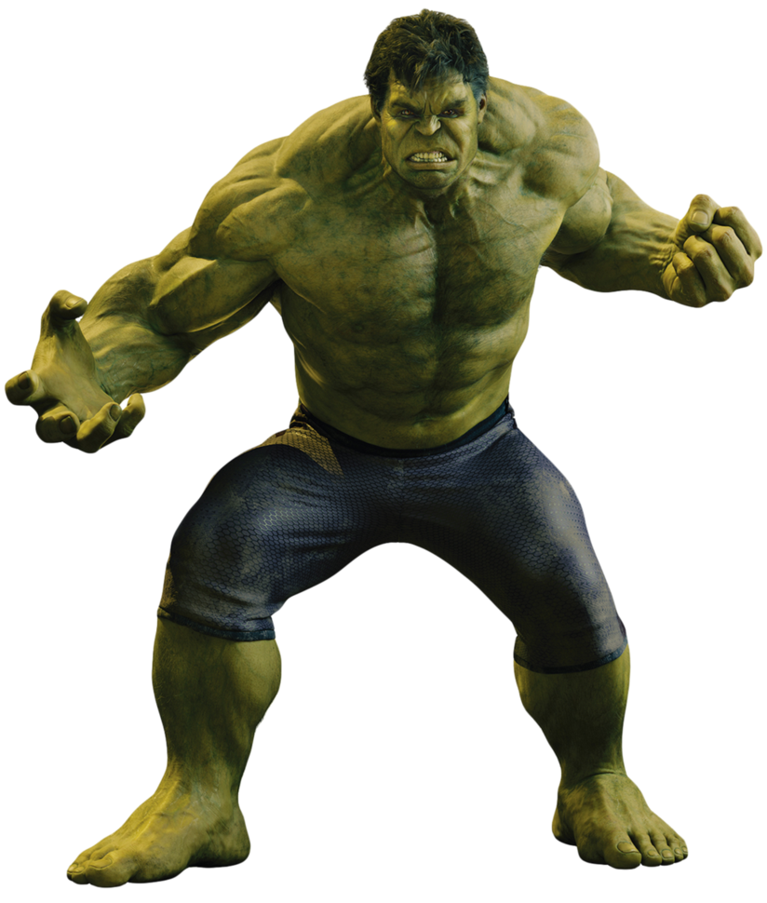
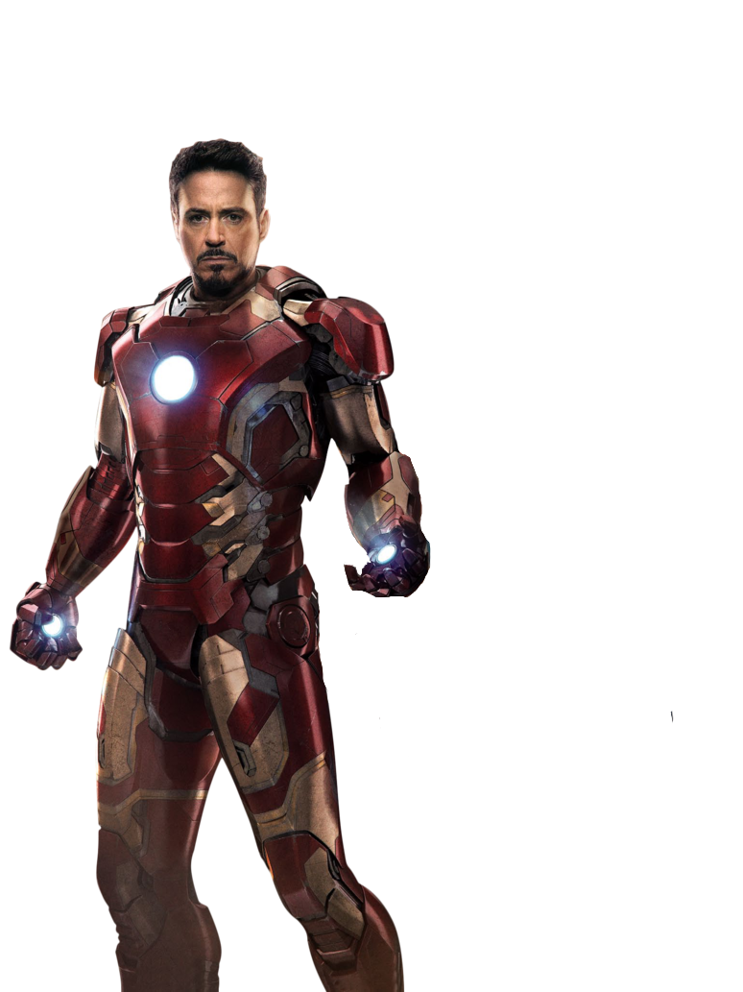
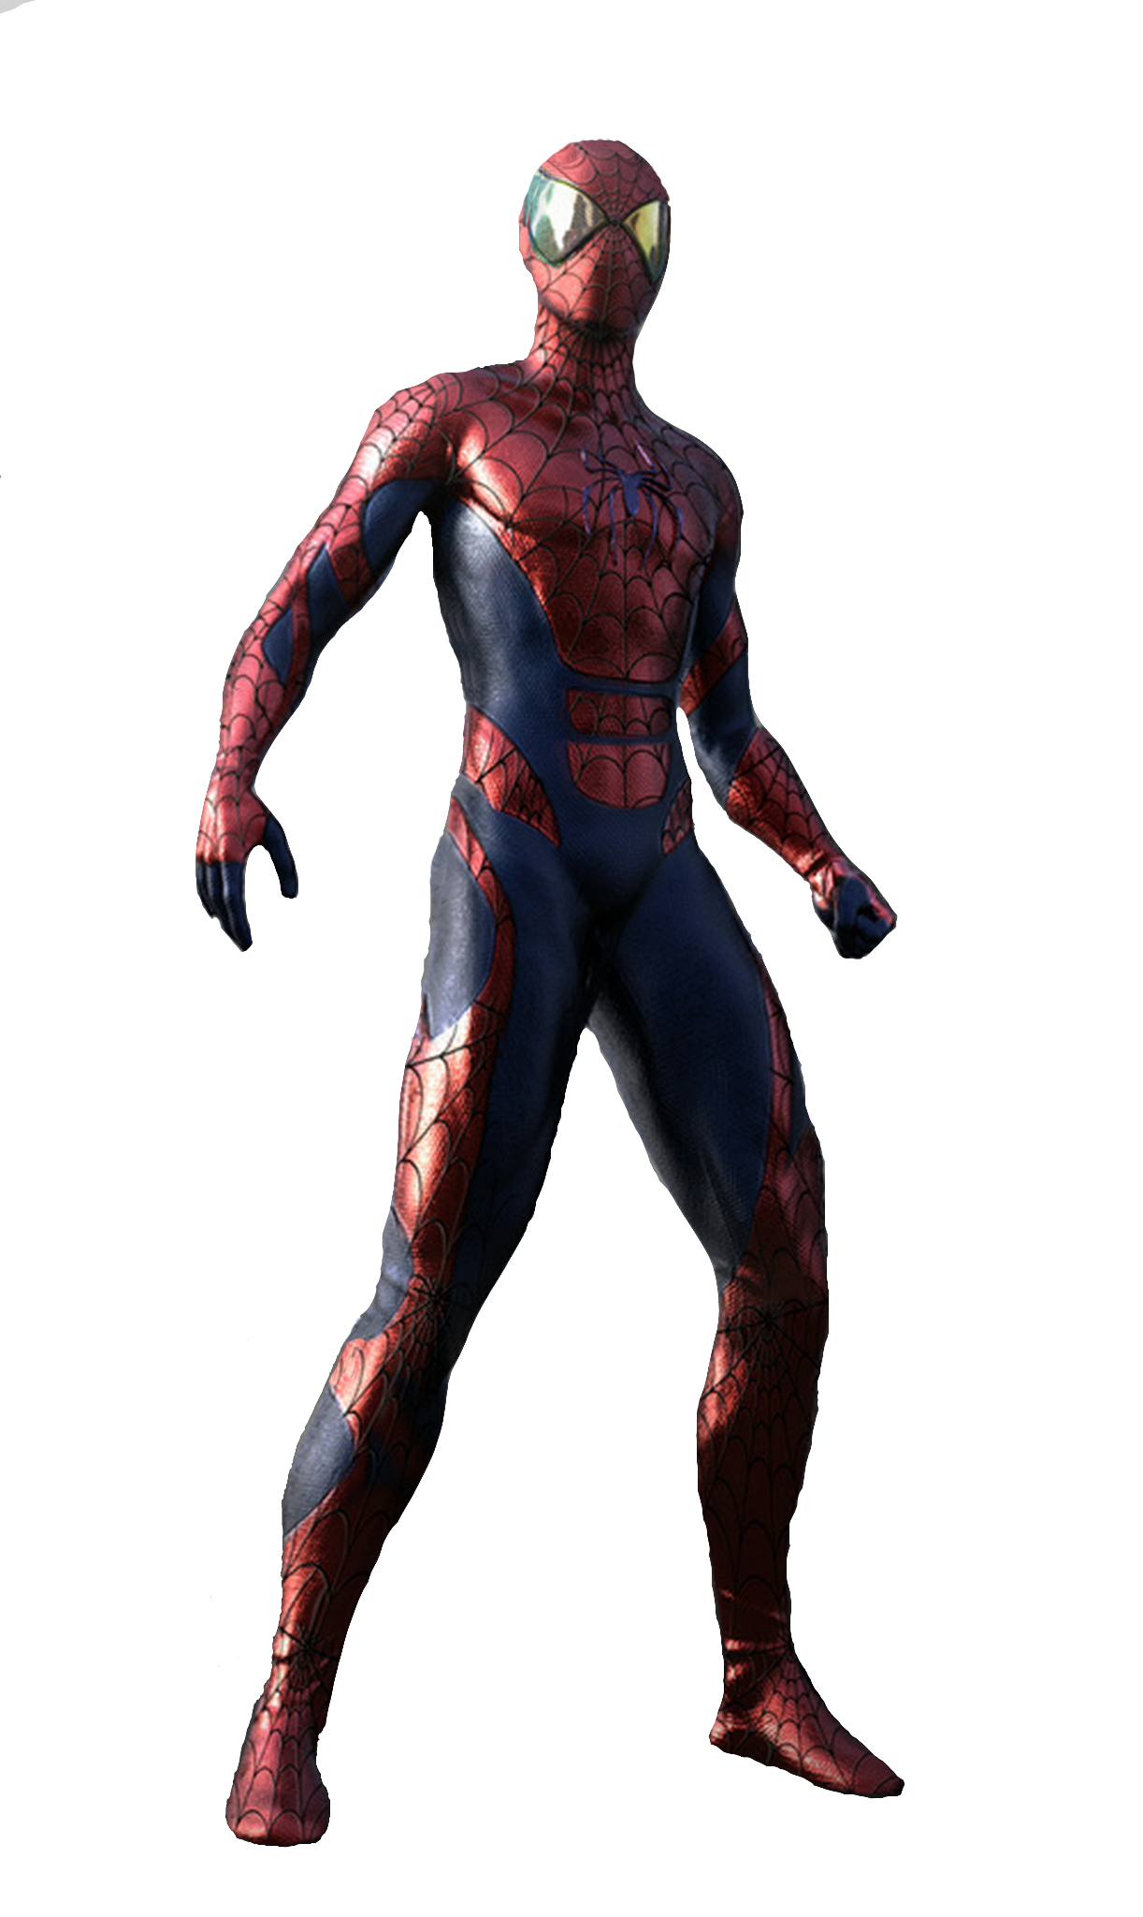
Citing Three or More Authors
Use only the first name with ‘et al.’
Stark et al. (2019) found that Thanos destroyed 50% of Earth’s population.

Slide 22

Note
When using 'et al.,' treat it as a plural noun.

Slide 23
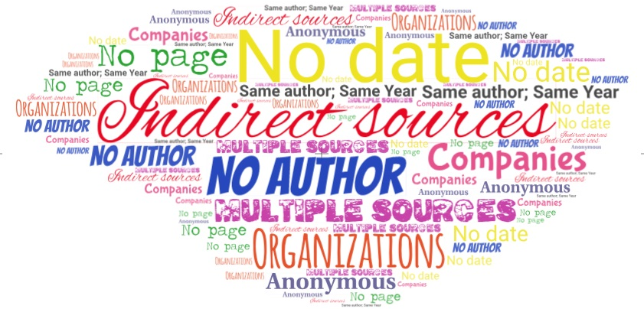

Slide 24
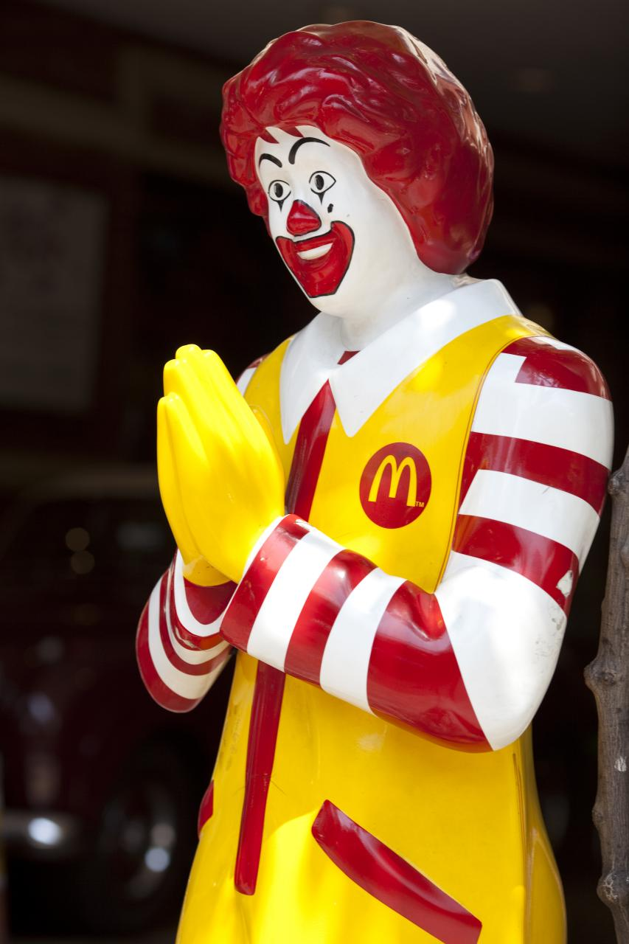
Companies or Organizations
Company name replaces author:
According to McDonald’s (2016), only 98% of their food items cause heart disease.

Slide 25
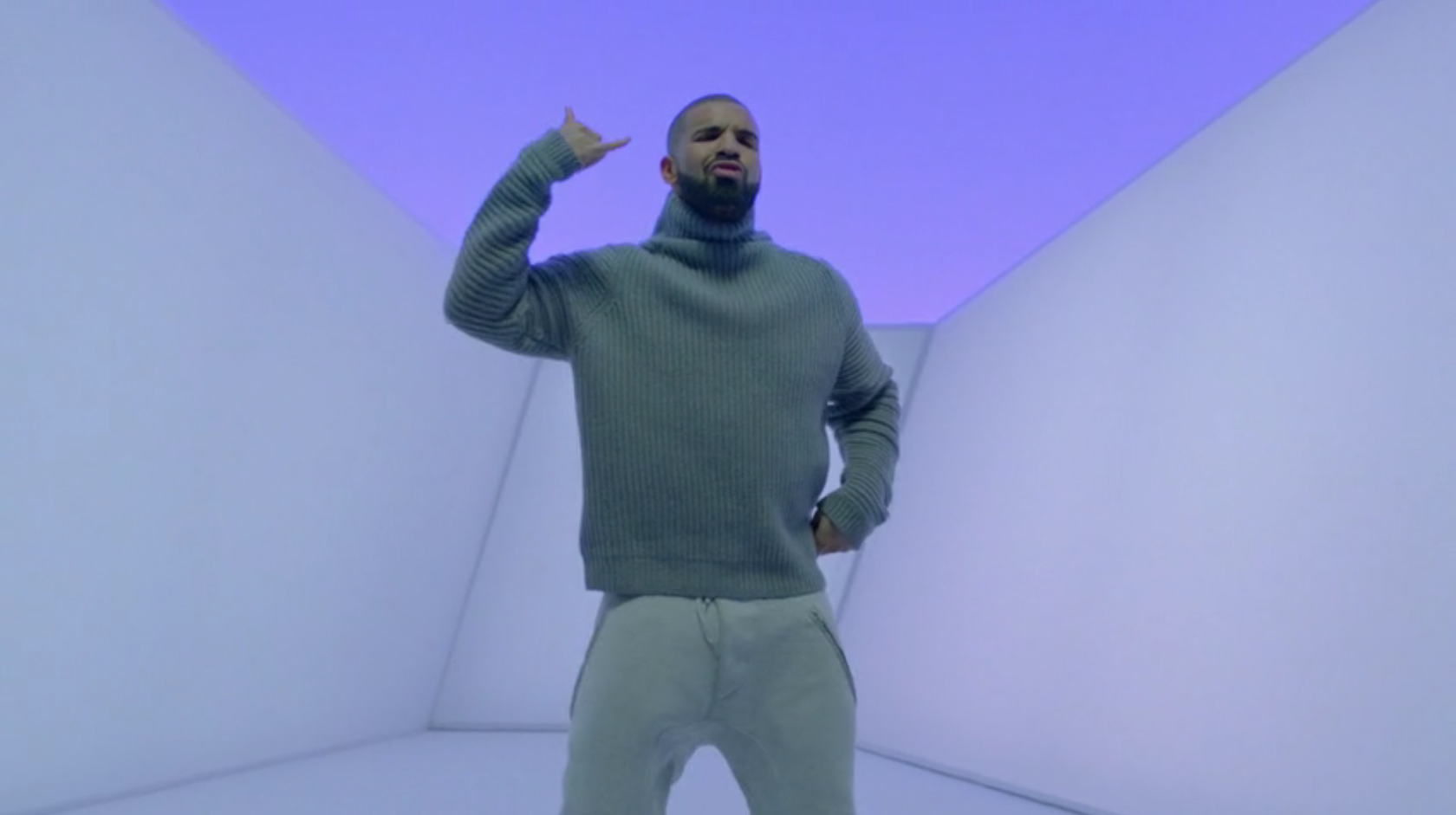
No Date
Use (n.d.) in place of the year:
According to Drake (n.d.), his friends used to call him on his cell phone.

Slide 26

Two Articles: Same Author; Same Year
Add lowercase ‘a’ and ‘b’ to the year of publication:
Though things will never be the same (Cabello, 2018b), people can always have a good time in Havana (Cabello, 2018a).

Slide 27

Note
The letters are attributed based on the alphabetical order of article titles.
The ‘a’ and ‘b’ appear in the reference in that order.

Slide 28

No Author
Article title goes in place of author:
Excess intestinal gas can lead to discomfort (“Flatulence,” 2014).

Slide 29
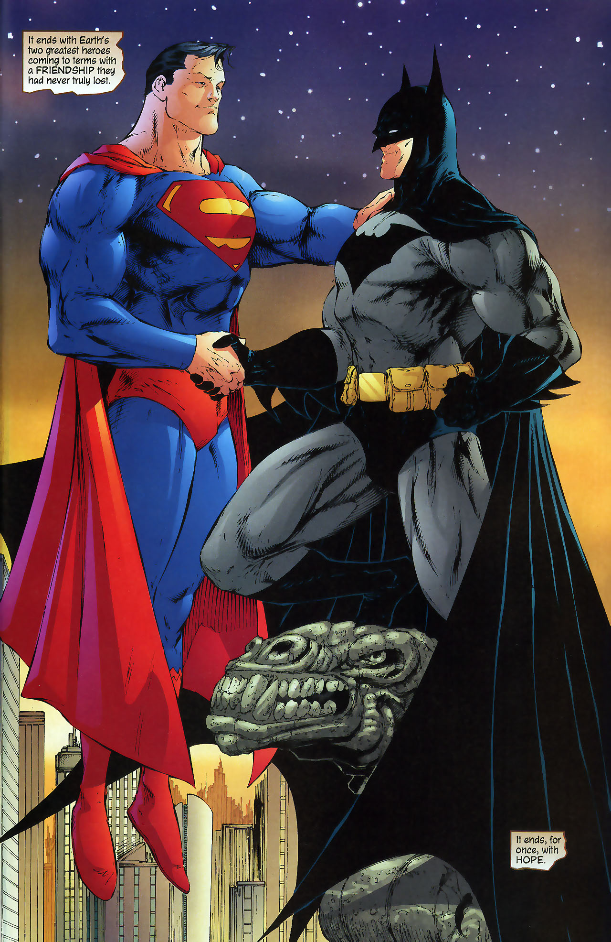
Indirect Sources
According to Wayne (2008), it is always handy to have green kryptonite around (as cited in Kent, 2009).

Slide 30
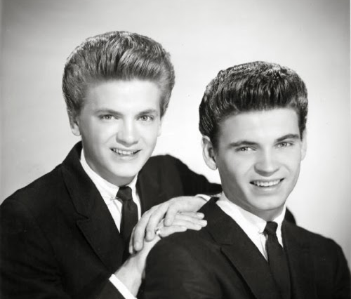
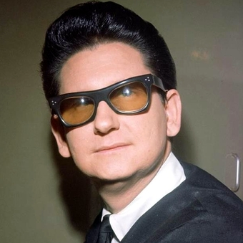
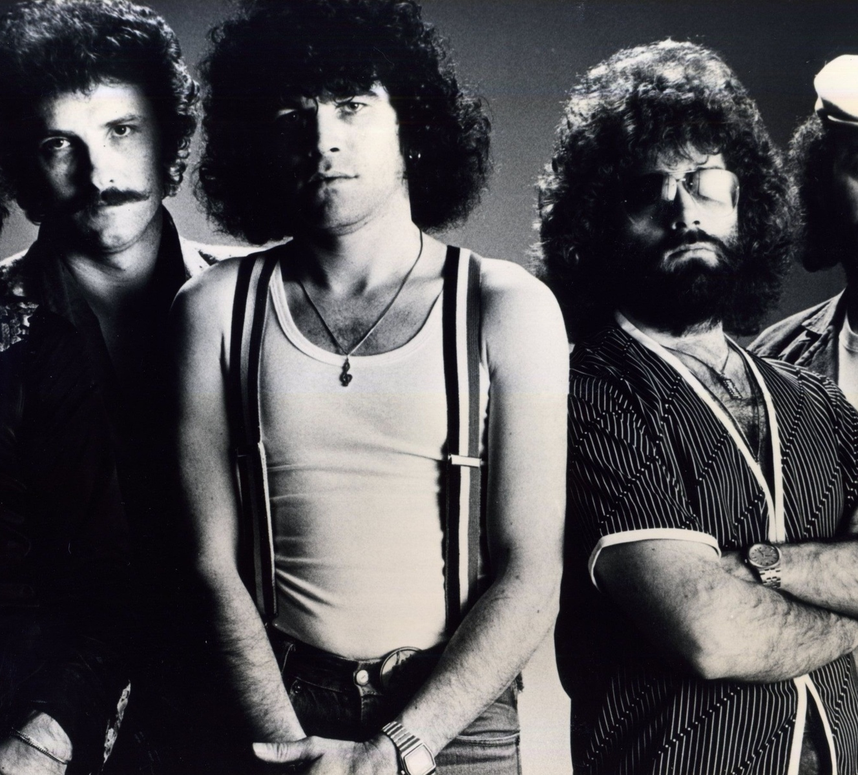
Multiple Sources at Once
Alphabetize them and link them with semicolons:
According to several reports, love hurts (Everly & Everly, 1960; Nazareth, 1975; Orbison, 1961).

Slide 31
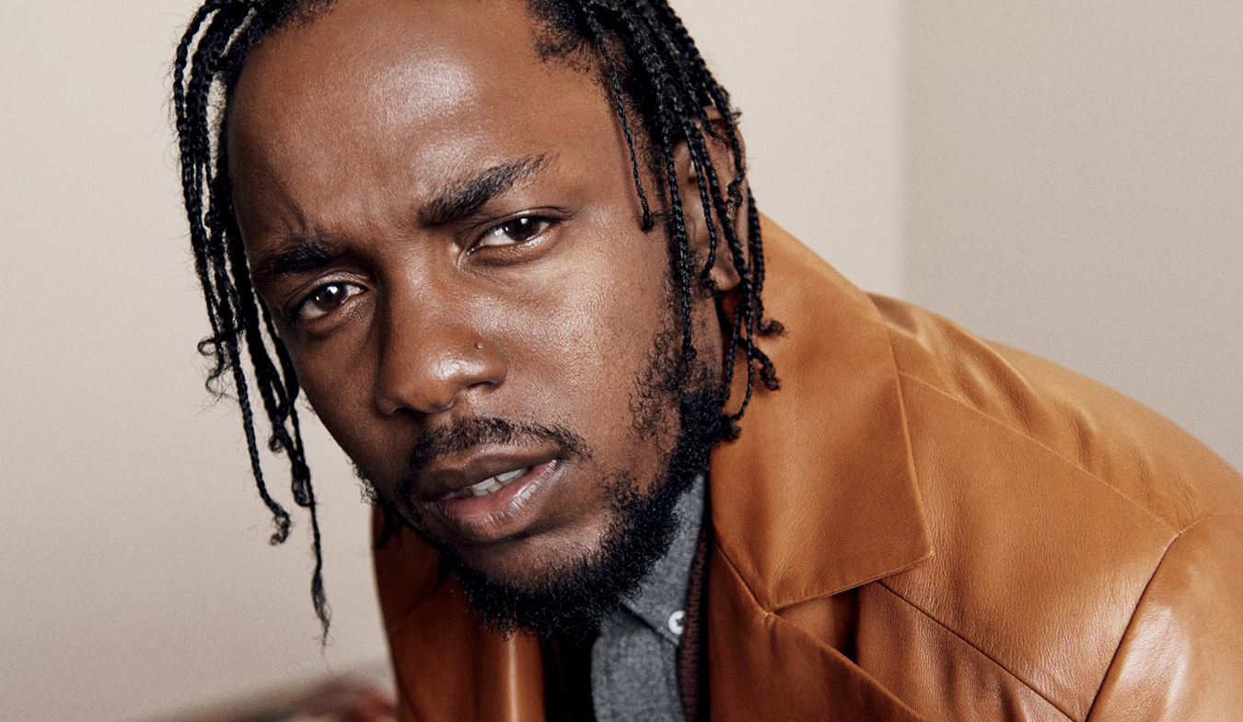
Works without a Page
Lamar (2018) argues that people should “sit down and be humble” (para. 2).

Slide 32
References: Authors
Single author
Two to twenty authors
More than twenty authors

Slide 33
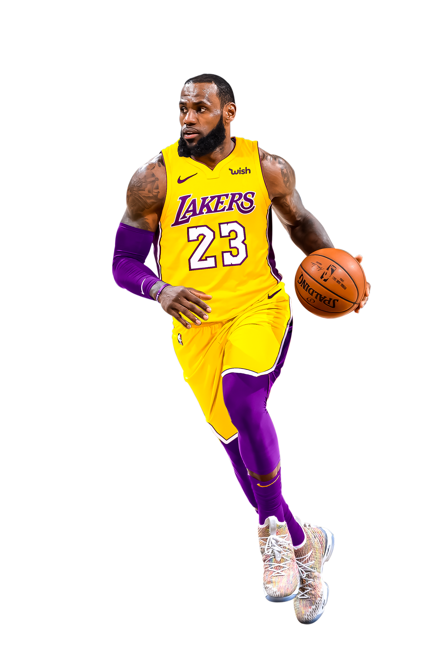
One Author
Author’s last name
A comma
Initials with period.
EXAMPLE
James, L. R.

Slide 34
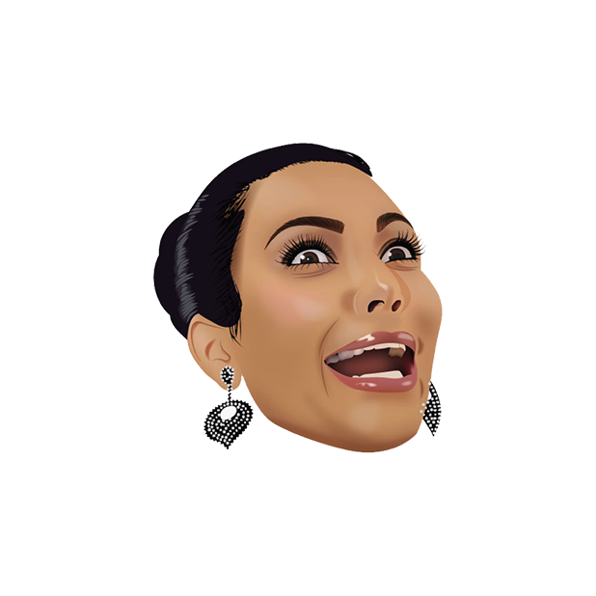
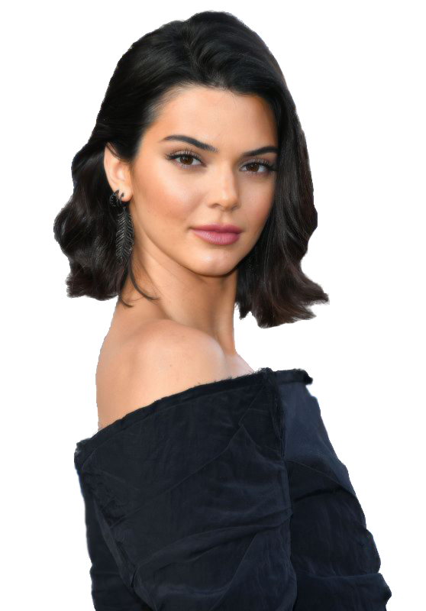

Two to Twenty Authors
A comma will be added after the final initial of each name
A ‘&’ symbol will precede the last name.
Closed with a period.
EXAMPLE
West, K., Kardashian, K., & Jenner, K.

Slide 35
More than Twenty Authors
List the first nineteen names.
Introduce an ellipsis
Add the final name listed in the source

Slide 36
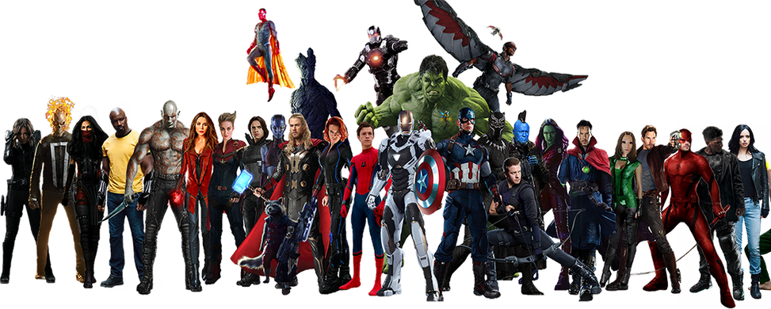
Example: More Than Twenty Author
Stark, T., Parker, P., Banner, B., van Dyne, D., Pym, H., Odinson,
T., Rogers, S., Romanoff, N. A., Danvers, C. S. J., McCoy,
H., Lang, S., Lang, C., Cage, L., Howlett, J. L., Jones, J. C.,
Strange, S., Murdock, M., Summers, A., Summers, S.,…
Surfer, S.

Slide 37
Titles such as ‘Jr.’ and ‘III’
Follow the initials.
Closed with a period.
Do NOT includes titles such as ‘Mr.’ or Dr.’
EXAMPLE
Vonnegut, K., Jr.

Slide 38

Preparing a Reference List: Questions To Ask Yourself
Source?
A book? A website? A scholarly article
Authorship?
A translator? An editor? An organization?
Date?
Year? Month? Volume? Issue?
Location?
The Internet? In a database? In the library?

Slide 39
Example: Online Journal
Gambino, C.
Note: The last name comes first, followed by an initial that has a period after it.

Slide 40
Example: Online Journal
Gambino, C. (2018).
Note: The year follows, in parentheses, and also has a period afterwards, outside of the parentheses.

Slide 41
Example: Online Journal
Gambino, C. (2018). This is America: We just want
the money.
Note: The title of the work is next. Only the first word, the first word of the subtitle and proper names will be capitalized. It is a short work, so it will NOT be in italics.

Slide 42
Example: Online Journal
Gambino, C. (2018). This is America: We just want
the money. American Sociological Studies,
Note: The title of the journal is next. Because it is a large work, it will be in italics, and all the major words will be capitalized. A comma will follow it to introduce the volume and issue number.

Slide 43
Example: Online Journal
Gambino, C. (2018). This is America: We just want
the money. The Journal of American Sociological
Studies,
Note: Don’t capitalize prepositions that are three letters or less, such as ‘of,’ ‘on,’ or ‘in.’

Slide 44
Example: Online Journal
Gambino, C. (2018). This is America: We just want
the money. The Journal of American Sociological
and Political Studies,
Note: Don’t capitalize conjunctions that are three letters or less, such as ‘and,’ ‘but,’ or ‘so.’

Slide 45
Example: Online Journal
Gambino, C. (2018). This is America: We just want
the money. The Journal of American Sociological
and Political Studies, 8(12),
Note: The volume number will follow, and will be in italics. The issue number comes immediately after with no space, and will be in parentheses. This is also followed by a comma.

Slide 46
Example: Online Journal
Gambino, C. (2018). This is America: We just want
the money. The Journal of American Sociological
and Political Studies, 8(12), 6-66.
Note: The page range of the article will follow. The first number is the first page of the article, and the second number is the last page number of the article. A dash will separate them and a period will follow.

Slide 47
Example: Online Journal
Gambino, C. (2018). This is America: We just want
the money. The Journal of American Sociological
and Political Studies, 8(12), Article number 12.
Note: If there is an article number instead of a page number, simply put the article number.

Slide 48
Example: Online Journal
Gambino, C. (2018). This is America: We just want
the money. The Journal of American Sociological
and Political Studies, 8(12), 6-66.
doi:0000000/0000000000
Note: Finally, the letters ‘doi’, which stands for ‘digital object identifier’, will follow. They will be in lowercase letters, and will be followed by a colon, and then the doi number. No period will follow and there will be no spaces.

Slide 49
Example: Online Journal
Gambino, C. (2018). This is America: We just want
the money. The Journal of American Sociological
and Political Studies, 8(12), 6-66.
http://dx.doi.org/10.1016/j.appdev.2012.05.0
05
Note: If the ‘doi’ cannot be found, you can use the doi link.

Slide 50
Example: Online Journal
Gambino, C. (2018). This is America: We just
want the money. The Journal of American
Sociological and Political Studies, 8(12), 6-66.
https://www.notarealwebsite.com/thisisfake
news
Note: If neither a doi nor a doi link can be found, you can use the URL instead. Type ‘Retrieved from’ and then the URL. Do not leave the hyperlink in.

Slide 51
Example: Chapter in a Book
Grande, A. (2018). God is a woman: Why you shouldn’t call
women ‘angel.’
NOTE: The chapter from a book will start the same way as an article from a journal.

Slide 52
Example: Chapter in a Book
Grande, A. (2018). God is a woman: Why you shouldn’t call
women ‘angel.’ In N. Minaj (Ed.),
NOTE: The title of the chapter will be followed by the word ‘In’ to signify it was in a book, and then the initials and last name of the editor or editors will follow with (Ed.) in parentheses for one editor, and (Eds.) for more than one.

Slide 53
Example: Chapter in a Book
Grande, A. (2018). God is a woman: Why you shouldn’t call
women ‘angel.’ In N. Minaj, J. Jessie, & B. Knowles (Eds.),
NOTE: If there is more than one editor, add an ‘s’: (Eds.).

Slide 54
Example: Chapter in a Book
Grande, A. (2018). God is a woman: Why you shouldn’t call
women ‘angel.’ In N. Minaj, J. Jessie, & B. Knowles (Eds.),
Challenging patriarchal power dynamics
NOTE: The title of the book will follow. As it is a long work, it will be in italics; however, unlike the journal, it gets the same capitalization rule as the short works.

Slide 55
Example: Chapter in a Book
Grande, A. (2018). God is a woman: Why you shouldn’t call
women ‘angel.’ In N. Minaj, J. Jessie, & B. Knowles (Eds.),
Challenging patriarchal power dynamics (pp. 45-62).
NOTE: The page rage of the chapter will come before the period and will be in parentheses.

Slide 56
Example: Chapter in a Book
Grande, A. (2018). God is a woman: Why you shouldn’t call
women ‘angel.’ In N. Minaj, J. Jessie, & B. Knowles (Eds.),
Challenging patriarchal power dynamics (pp. 45-62).
https://www.notarealwebsite.com/thisistotallyfakenews
NOTE: The city of publication will follow, then a comma, then an abbreviation of the province, state, or territory. A colon will then introduce the name of the publisher, and the reference will then be closed off with a period.

Slide 57
Example: Chapter in a Book
Grande, A. (2018). God is a woman: Why you shouldn’t call
women ‘angel.’ In N. Minaj, J. Jessie, & B. Knowles (Eds.),
Challenging patriarchal power dynamics (pp. 45-62).
Illuminati Press.
NOTE: The city of publication will follow, then a comma, then an abbreviation of the province, state, or territory. A colon will then introduce the name of the publisher, and the reference will then be closed off with a period.

Slide 58
Hanging Line
The first line of the reference will be left aligned with no indent. The lines under the first line will all be indented. This is called a ‘hanging’ line.
To achieve this effect, do not simply hit the ‘tab’ button. Instead, highlight the entire reference page, right click, and select ‘Paragraph’.
Then, under the ‘Indentation’ subheading, open the dropdown menu. You will have three options: ‘None’, ‘First Line’, and ‘Hanging’. Select hanging, and then click ‘OK’ on the bottom right-hand corner of the pop-up window.

Slide 59
A Word About Citation Generators…
Many students use citation generators such as:
Citation Machine
BibMe
EasyBib, etc.
However, this technology is NOT foolproof, and OFTEN results in improper citations!!
You still need to know how to reference your sources properly. The best way is to check the style guide or The Purdue OWL.
Bottom Line: Know how to cite properly so you don’t end up with unnecessary mistakes in your reference list!

Slide 60


Slide 61
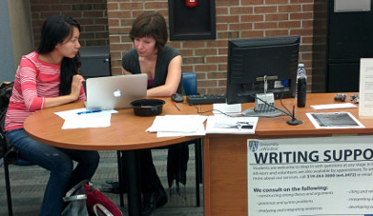
Still Have Citation Questions?
There are ways to cite every kind of published or unpublished work, no matter what the medium. If you’re not sure how to cite something, look it up on the Purdue OWL, or come see us at the Writing Support Desk in Leddy Library!

Slide 62
References
American Psychological Association. (2010). Publication Manual of the American Psychological Association (6th ed.). Washington, DC: American Psychological Association.
The Purdue OWL. Purdue U Writing Lab, 2010. Web. Nov. 1, 2014.
All image retrieved from Microsoft Office, or Bing image search.
Presentation created by Greg Paziuk, Jason Horn, and Joanna Marzec, 2013-16.

